Slide 1
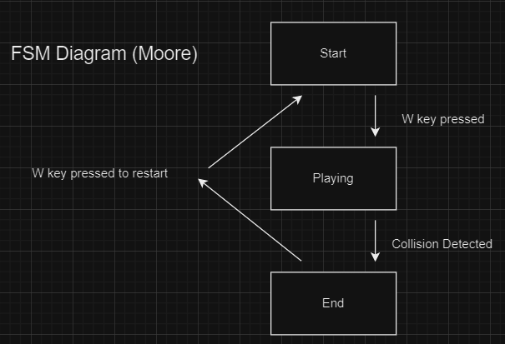
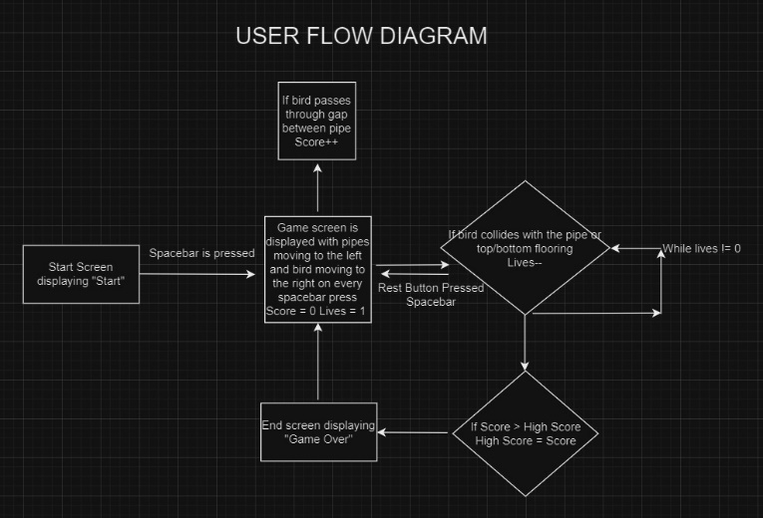
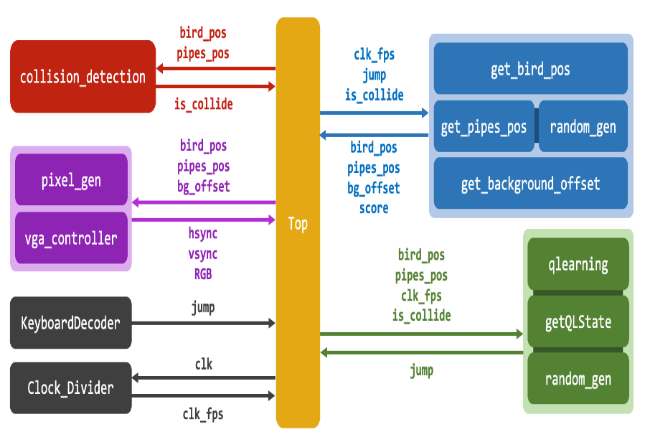
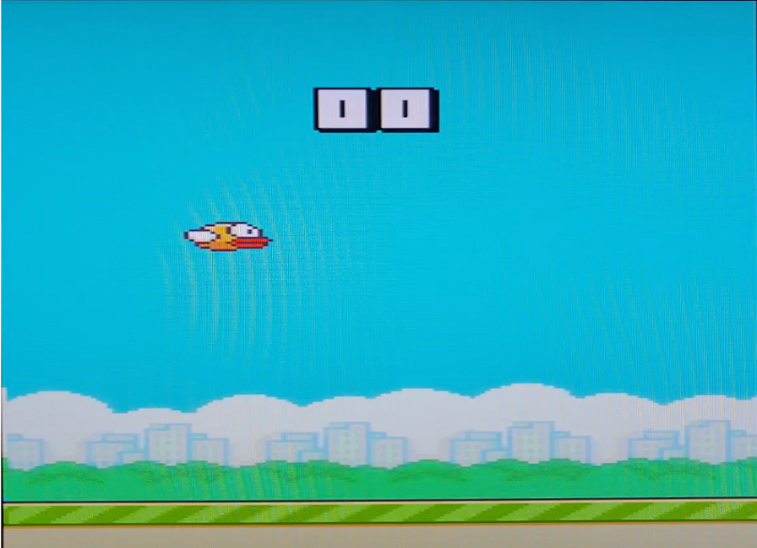
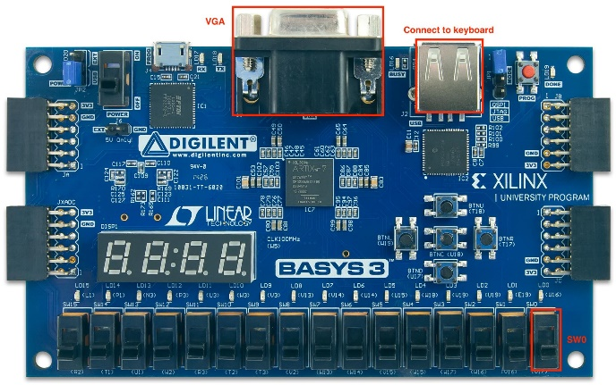
Catch Your Breath Yumman Bashir, Rameez Wasif, Ubbad Rizvi, Wasay Munawar
Introduction
This project involves creating a simplified version of Flappy Bird on an FPGA board. Players control a bird that moves horizontally and can flap upward with the space key. The goal is to navigate the bird through pipes without touching them, the ground, or the sky. The game uses keyboard input and VGA output. Additionally, the bird will be trained to play the game using Q-Learning (Reinforcement learning) and aim for high scores. It's a casual yet engaging game suitable for anyone with a competitive spirit.
FSM State Transition Diagram
User Flow Diagram
Top Module Details
Results
System Diagram

